Slide 1
WorkshopPLUS Power Platform for Administrators
Center of Excellence Starter Kit
Notes:
Workshop Version: 2.6

Slide 2
Conditions and terms of use
© Microsoft Corporation. All rights reserved.
You may use these training materials solely for your personal internal reference and non-commercial purposes. You may not distribute, transmit, resell or otherwise make these training materials available to any other person or party without express permission from Microsoft Corporation. URL’s or other internet website references in the training materials may change without notice. Unless otherwise noted, any companies, organizations, domain names, e-mail addresses, people, places and events depicted in the training materials are for illustration only and are fictitious. No real association is intended or inferred. THESE TRAINING MATERIALS ARE PROVIDED “AS IS”; MICROSOFT MAKES NO WARRANTIES, EXPRESS OR IMPLIED IN THESE TRAINING MATERIALS¹

Slide 3

Objectives
After completing this Learning, you will be able to understand:
 | 1 | Fundamentals of Power Platform governance
 | 2 | What Center of Excellence (CoE) Starter Kit is and what it has to offer to better govern your Power Platform investment
 | 3 | Details of CoE Core, Audit Log components and Power BI Dashboard

Slide 4
Fundamentals of Power Platform governance

Slide 5
Power Platform is Designed For Everyone
Low-code gives rise to more developers
End Users
Experienced Developers
IT/Admins
Notes:
The Power Platform is designed for ease of use for business or departmental users, the world’s growing citizen developer community, yet also offers the functionality required for experienced developers. Power Platform is also built to support the needs of modern IT teams and Admins, from automating mundane IT functions, to providing security, compliance, and control over the usage and execution of Power Platform services across the IT ecosystem.
Our focus for the next several minutes will be how the Power Platform is designed to work with IT in this new world of end users and experienced developers. Let’s first map out the changes that IT will face.

Slide 6
Digital Transformation is Powered By People
End users will be creating many more apps than experienced developers in the coming years
Experienced Developers
4x
End Users
Notes:
For modern businesses to compete and progress with their digital transformation journey, more end users will become developers. In fact, Gartner predicts that by 2023, there will be four times as many end user or citizen developers compared to experienced developers in enterprises.
Gartner conducted a recent survey finding that 41% of respondents have active citizen development and an additional 20% are currently evaluating or initiating citizen development within the enterprise.
This new group of developers are needed to handle an increase in software, application, and database development required for the modern enterprise to support growing business demands.

Slide 7
The Growing Number of Developers Creates A New Norm
IT must adapt to the growing number of non-technical developers
Shadow IT becomes Citizen IT
Securing your perimeter means securing your people
More Data Sharing Requires Stronger DLP
Better Visibility and custom configurations
Notes:
As the number of developers grows, the realities of the organization change. For example, what once might be considered shadow IT or rogue IT and discouraged, might now be considered citizen IT where an end user creates own application to expedite a process or task. Security really becomes securing the user identity rather than securing the network perimeter. As more users gain access to data, DLP becomes more important. Also, greater customizations are required for organizations’ unique IT environments.

Slide 8
More Developers Require More Governance
Do any of these challenges sound familiar to you?
Business data security concerns regarding connectors
Compliancy issues regarding GDPR
Environment health regarding trial setup
ALM support regarding apps being created/ deployed
Maintenance challenges regarding app and flow distribution
Staff turnover challenges regarding app or flow ownership
Security risks regarding “shadow IT”
Information risk management

Slide 9
Power Platform Empowers IT Admins with Governance Capabilities
Empowering admins with full visibility and the tools needed to balance business productivity with governance
Makes governance a mandate
Helps Develop & Implement a Strategy
Allows flexibility when needed

Slide 10
Governance – Practically Applied
IT must adapt to the growing number of non-technical developers
Secure
Monitor
Manage
Define your environment strategy
Configure data loss prevention policies
Configure data gateways and tenant isolation
Set up shared user productivity environments
Review out-of-box analytics
Configure audit logs
Extract telemetry for ad-hoc reporting
Automate policies using management connectors
Leverage admin PowerShell or admin APIs for automation
Application Lifecycle
Managed vs Unmanaged
Learn ALM best practices
Automate ALM using Azure DevOps
Nurture and educate
Establish a Center of Excellence
Educate new makers
Foster best practices

Slide 11
Introduction to Center of Excellence (CoE) Starter Kit

Slide 12
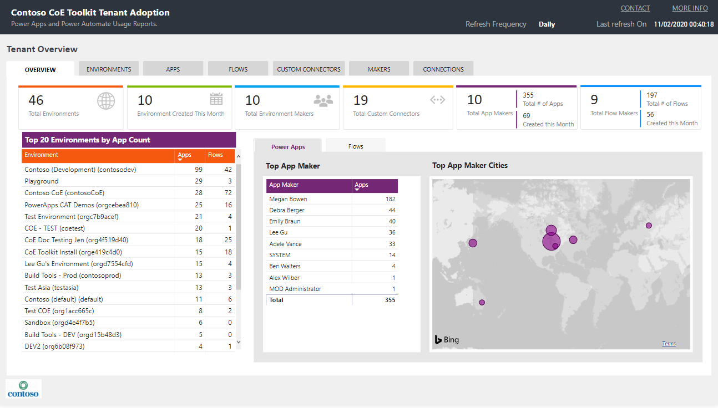
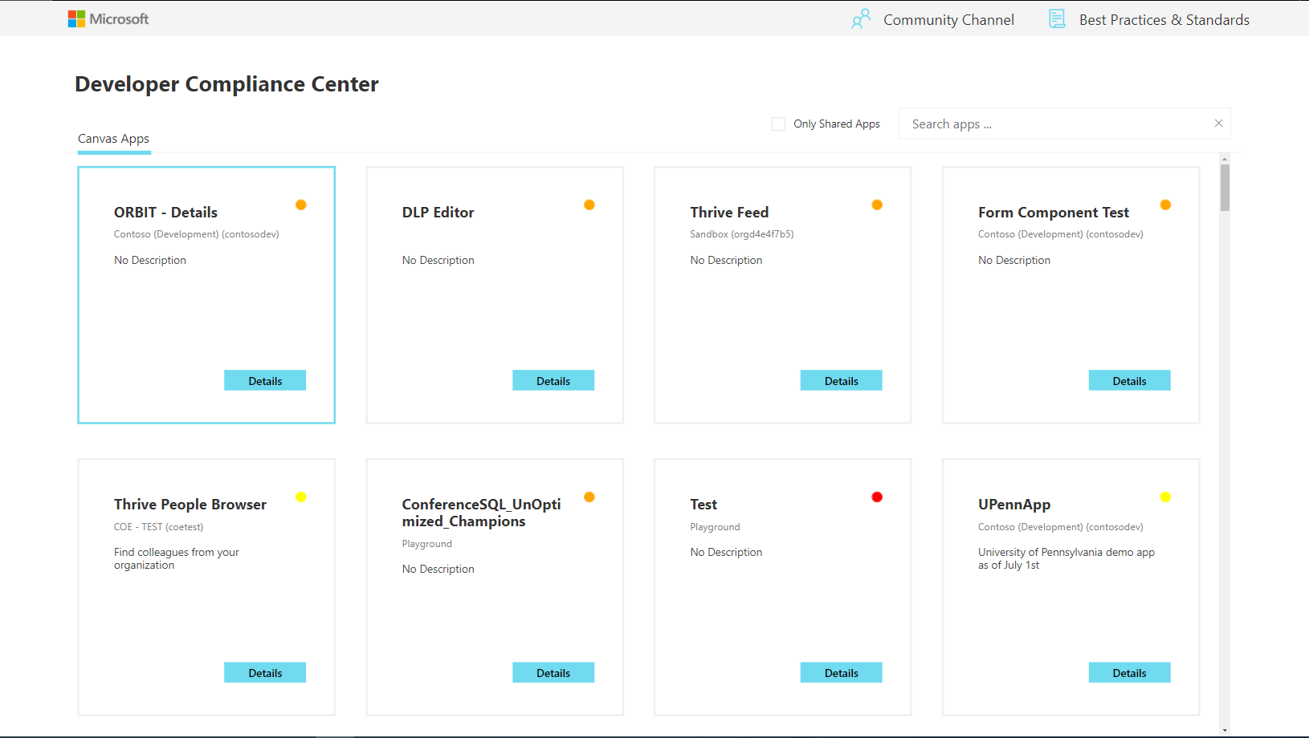
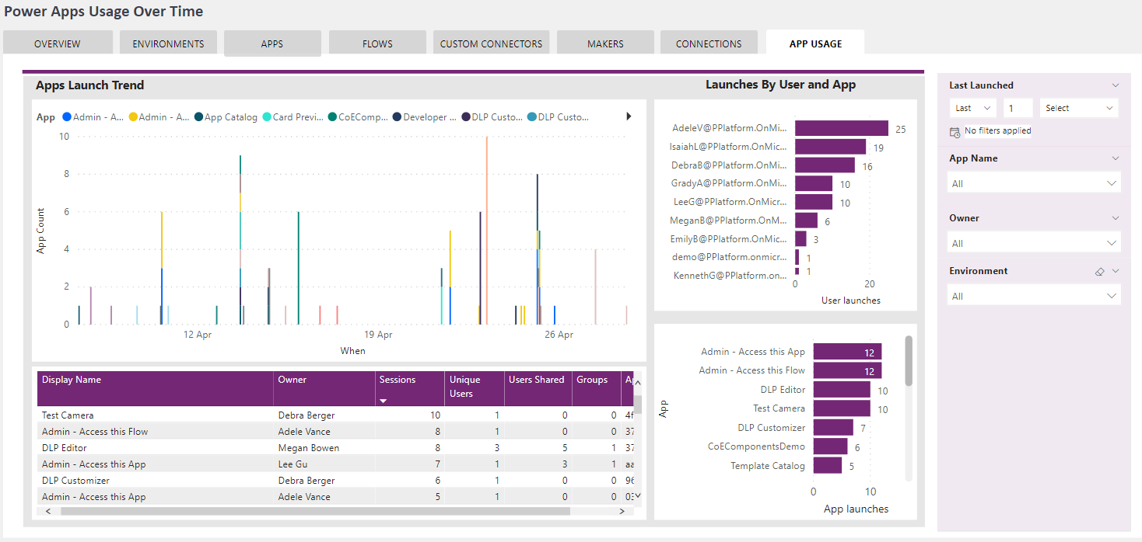
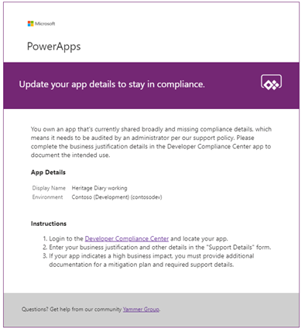
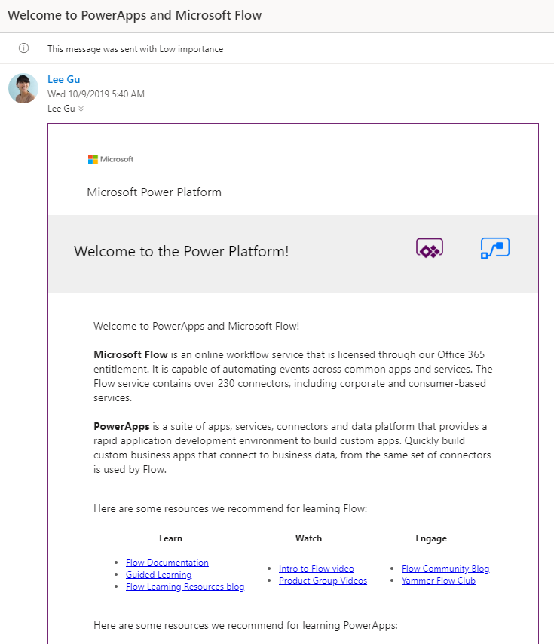
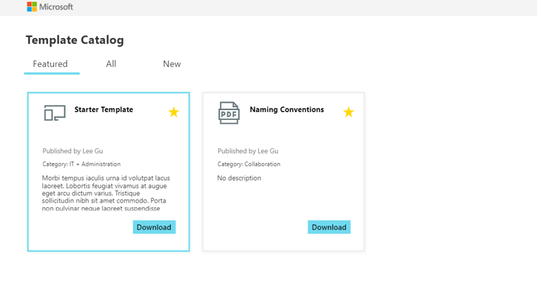
What is Center of Excellence Starter Kit?
The Center of Excellence or CoE for short is a collection of components and tools, which are designed to help you get started with developing a strategy for adopting and supporting the Power Platform. It includes a templatized implementation of best practices.
Adopting it can give you the
Ability to better administer the platform with a dashboard that gives you full visibility
Ability to govern with a sample audit process
Ability to nurture with template catalog to share best practices, and welcome email to welcome new makers.
Starter Kit might not match every organization's requirements, so we recommend that you extend the solution to fit your organization's requirements.

Slide 13
Better together
Managed Environments
Out of the box governance capabilities to manage the Power Platform at scale with more visibility, more control and less effort.
CoE Starter Kit
An open-source low code reference implementation of proven practices to get started, accelerate and nurture your Power Platform Adoption, based on years of customers experiences and feedback
https://aka.ms/MEGuidance
https://aka.ms/coeskme
Getting Started: Start with the out of the box Power Platform Admin Center and Managed Environments. Explore the CoE Starter Kit and adopt workflows and insights to augment your governance strategy
On Going: Follow what’s new in Managed Environments, and what innovations have been added to the COE Starter Kit (Influence by joining https://aka.ms/coeofficehours). Extend your toolbox with homegrown or 3rd party solutions where needed.
Notes:
Once you have established your desired processes, looking at opportunities for automation will be key to allow your CoE team to scale. We have made the CoE Starter Kit available as a representation of what we’ve learned from some of the largest organizations implementing Power Platform. It’s a collection of templates and components that designed to help you get started with developing a strategy for adopting and supporting the Power Platform, based on what we’ve seen successful customers do. However, installing is not a checkbox exercise. This tool, built in Power Platform, is intended to be just that: a starter kit for technology to enable your processes. It can help with the how, once you’ve established the what and why.
Some of the data and foundation you’ll likely need is in here, but your organization will undoubtedly want to tailor this for its own use. In many ways, to harness the true power of the kit you will adapt it to your own use cases and tailor it to your processes.

Slide 14
How to use the CoE Starter Kit alongside the product?
CoE Starter Kit
Managed Environments
Power Platform Admin Center
Custom tooling
Start with the out of the box capabilities in Power Platform admin center and Managed Environments.
Those capabilities are robust in the product and fully supported.
And if you discover you need more capabilities to govern your tenant, see if features in the CoE Starter Kit can complement what you get out of the box.
If that still doesn’t meet your requirements, explore extending and customizing the CoE Starter Kit or building your own tooling from scratch.
Notes:
Start with the out of the box capabilities in Power Platform admin center and Managed Environments.
Those capabilities are robust in the product and fully supported.
And if you discover you need more capabilities to govern your tenant, see if features in the CoE Starter Kit can complement what you get out of the box.
If that still doesn’t meet your requirements, explore extending and customizing the CoE Starter Kit or building your own tooling from scratch.
At the end of this section, after we’ve introduced some CoE kit features, we’ll explore how they can be used together with PPAC/ME features.

Slide 15
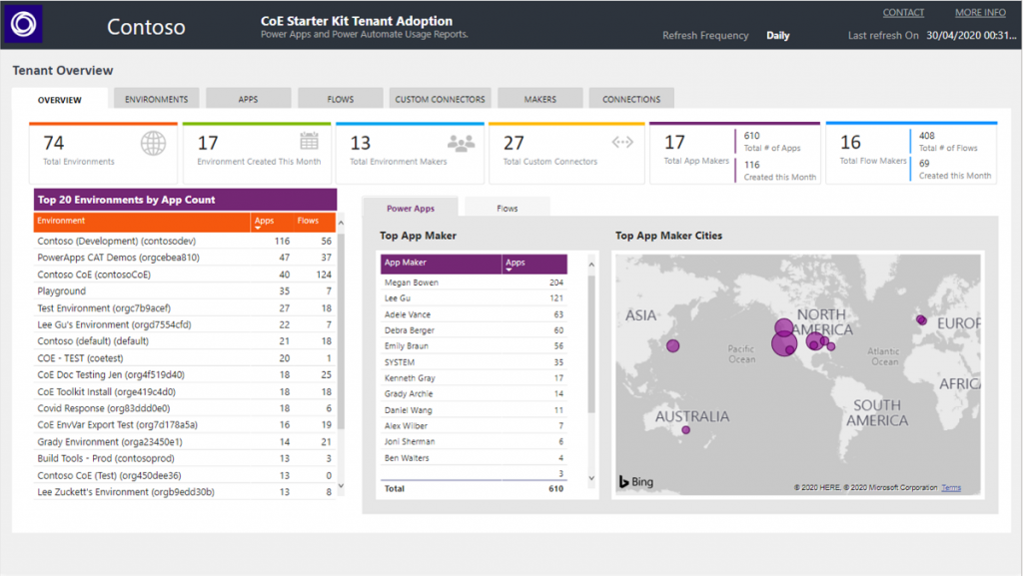
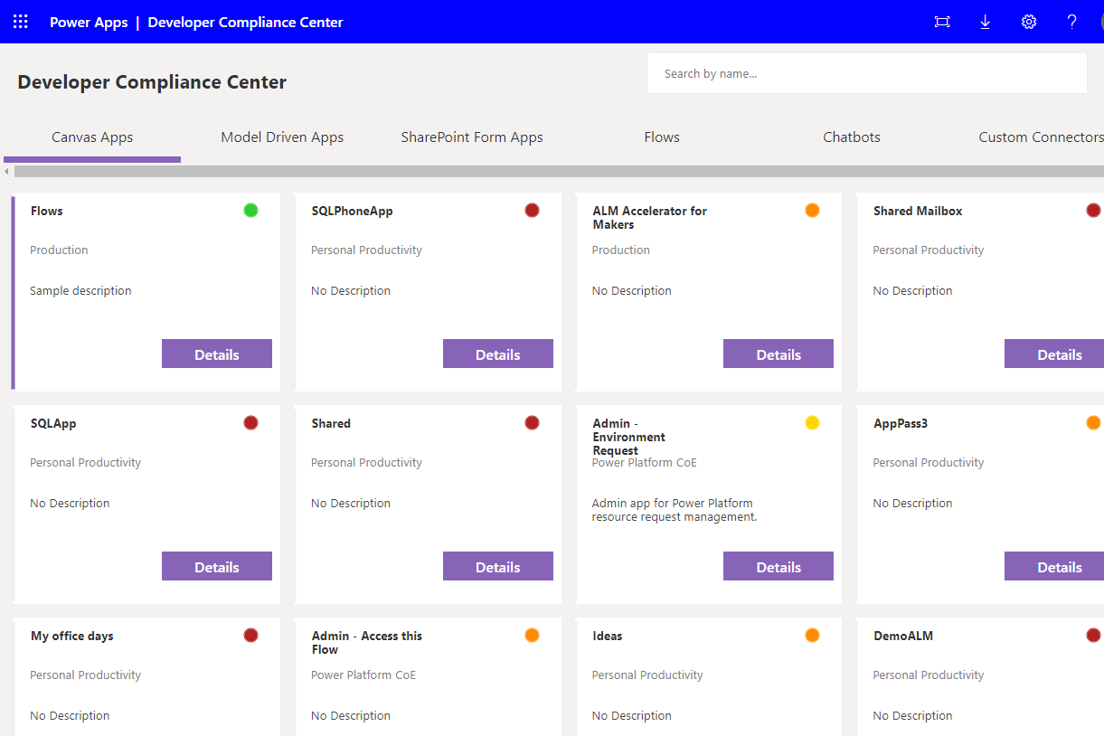
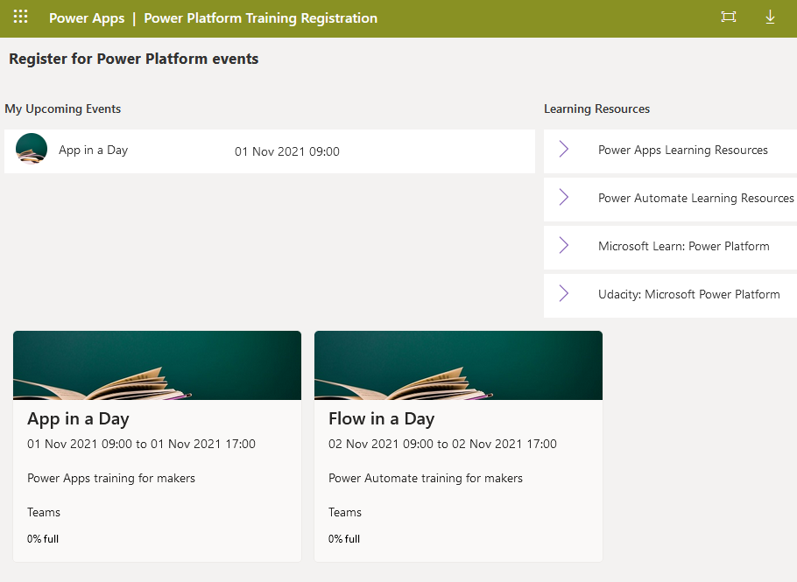
Building Blocks
Center of Excellence Starter Kit
Admin
Gain Insights into your Power Platform adoption
Governance
Establish Audit, Compliance and Archive processes
Nurture
Accelerate your adoption with a thriving community

Slide 16
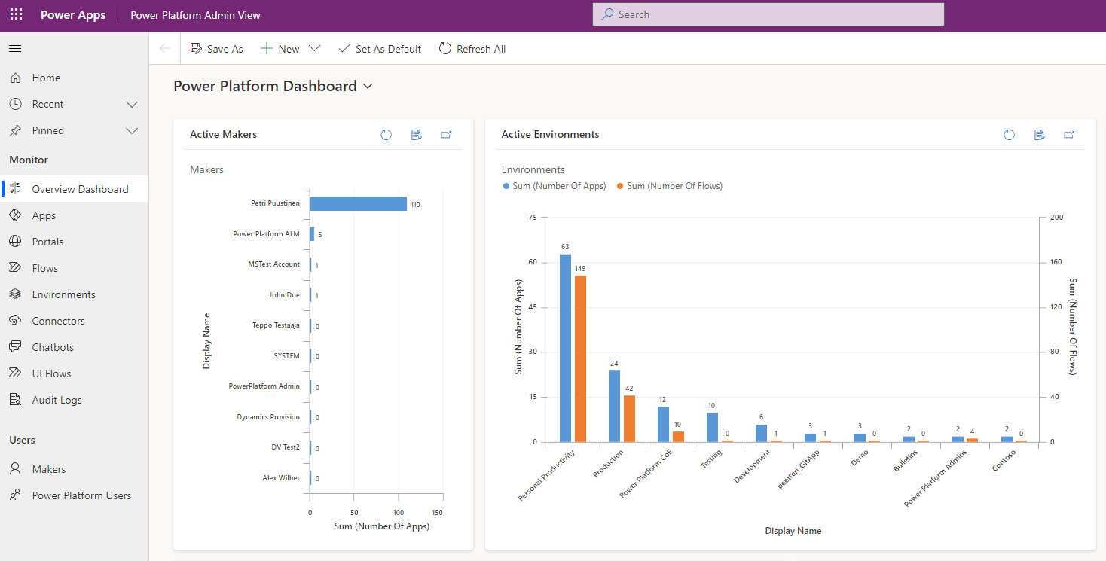
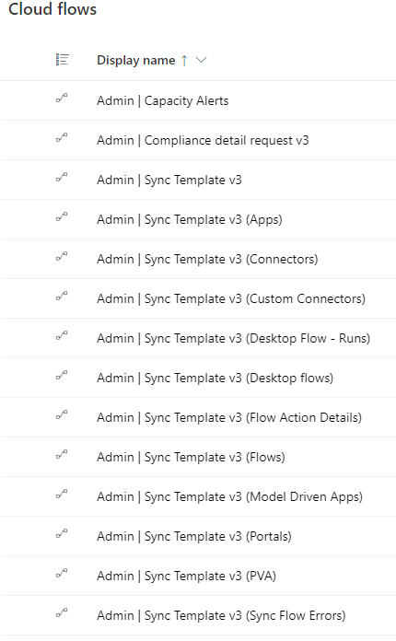
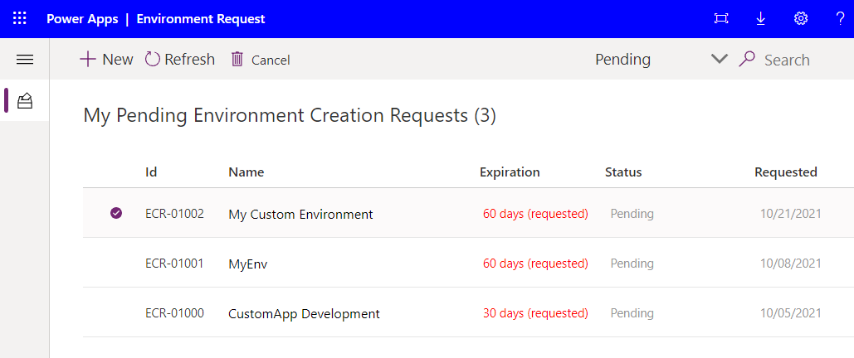
Admin Components - Core
CoE Starter Kit Building Blocks
Provides the core to get started with setting up a CoE – including Sync Flows to gather information about all your resources stored in Dataverse tables. Apps and reports built on top of that helps you get more visibility of what apps, flows, and makers are in your environment.
Contains mainly assets relevant to admins but also provides foundation for some of the other CoE components like Governance and Nurture.

Slide 17
Governance Components – Audit & Compliance
CoE Starter Kit Building Blocks
After you've become familiar with your environment and resources, you might start thinking about audit and compliance processes for your apps.
You might want to gather additional information about your apps from your makers or audit specific connectors or app usage. The apps and flows that are part of this solution help you get started.

Slide 18
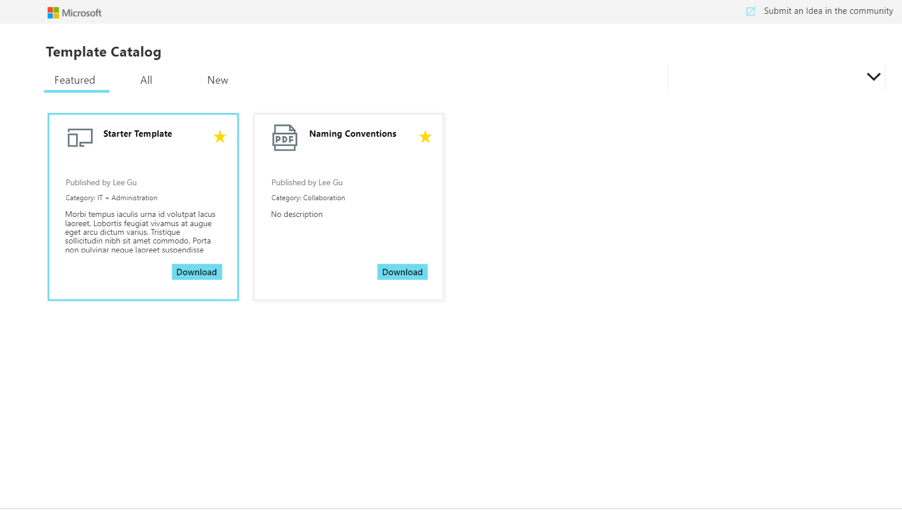
Nurture Components - Learning
CoE Starter Kit Building Blocks
An essential part of establishing a CoE is nurturing your makers and an internal community. You'll want to share best practices and templates and onboard new makers – the assets part of this solution can help develop a strategy for this motion.
The Nurture Components solution contains assets relevant to everyone in the organization, admins, makers and end users of apps and flows.

Slide 19
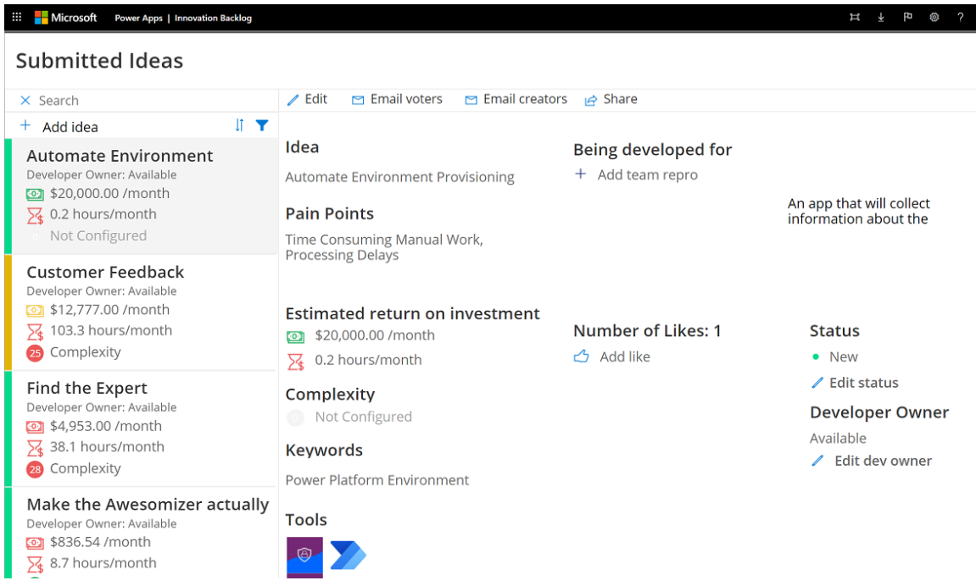
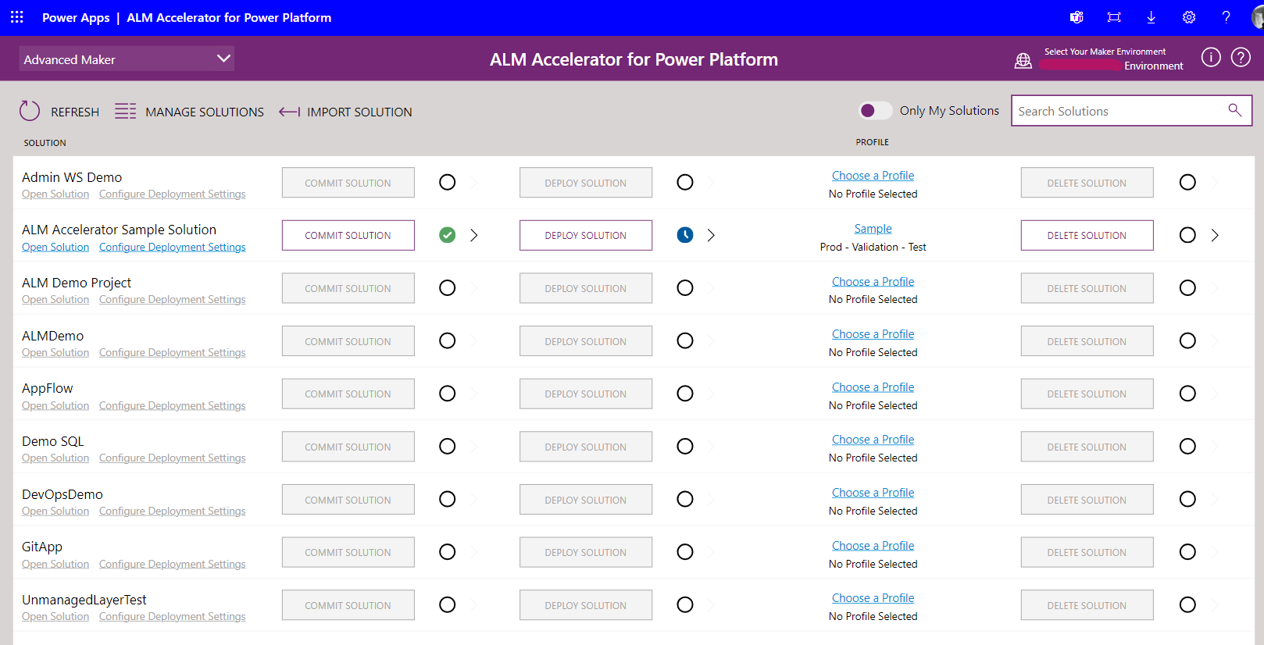
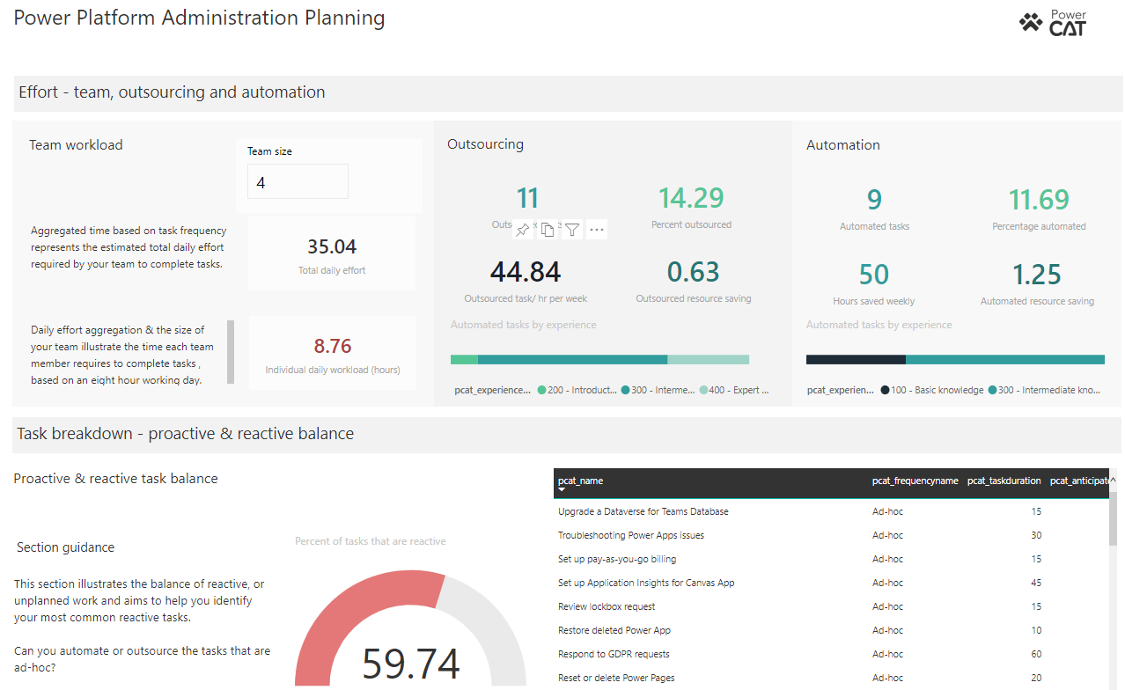
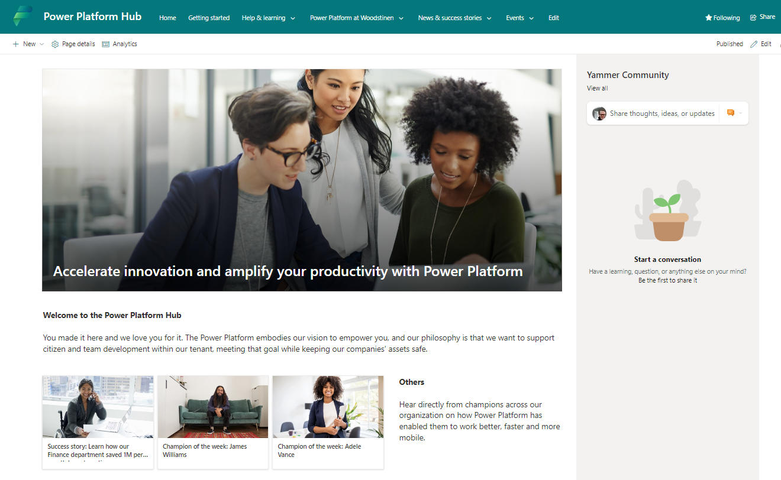
Standalone Add-ons
Center of Excellence Starter Kit
Innovation Backlog
Submit ideas for apps and flows that need building
ALM Accelerator
Implement Application Lifecycle Management patterns and practices for source control
Administration Planning
Plan your team structure and review where you spend time and look for automation or innovation opportunities.
Power Platform Hub
Power Platform community and wiki for sharing success stories, upcoming events, rules of engagement and guidelines with your makers

Slide 20
Innovation Backlog - Ideas
CoE Starter Kit Standalone Add-ons
Use the Innovation Backlog app to ask users to submit ideas for apps and flows that need building and describe pain points with the current process. As users describe the process, they'll provide information about personas involved, tools used, and measures for improvement. This information is then used to calculate an ROI and complexity score
The theming components solution doesn't have a dependency on other components of the CoE Starter Kit, so it can be used independently.

Slide 21
ALM Accelerator for Power Platform (AA4PP)
CoE Starter Kit Standalone Add-ons
Enable makers to apply source-control strategies with Azure DevOps, and use automated builds and deployment of solutions to their environments without the need for manual intervention by the maker, administrator, developer, or tester.
Helps makers work without intimate knowledge of downstream technologies and switch quickly from developing solutions to source-controlling the solution and, ultimately, pushing their apps to other environments with as few interruptions to their work as possible.

Slide 22
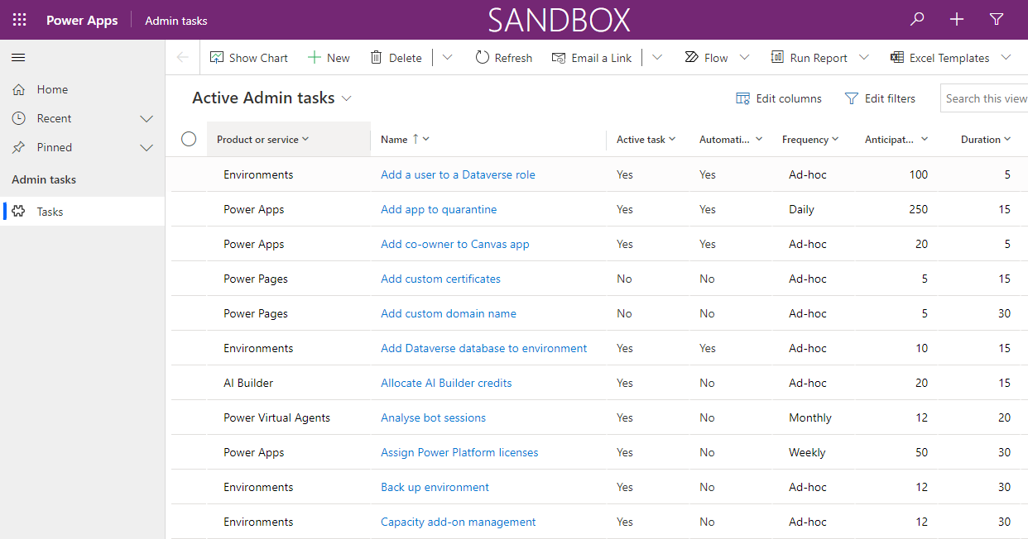
Administration Planning
CoE Starter Kit Standalone Add-ons
Behind the scenes, your IT and Center of Excellence team spends time configuring, managing and nurturing the adoption of Microsoft Power Platform. Understanding how that time is spent can help you plan who you need on your team and find the highest-impact opportunities to streamline the administrative effort.
Microsoft Power Platform administration planning is designed to help you:
Better plan your team structure.
Review where you spend time and look for automation or innovation opportunities.

Slide 23
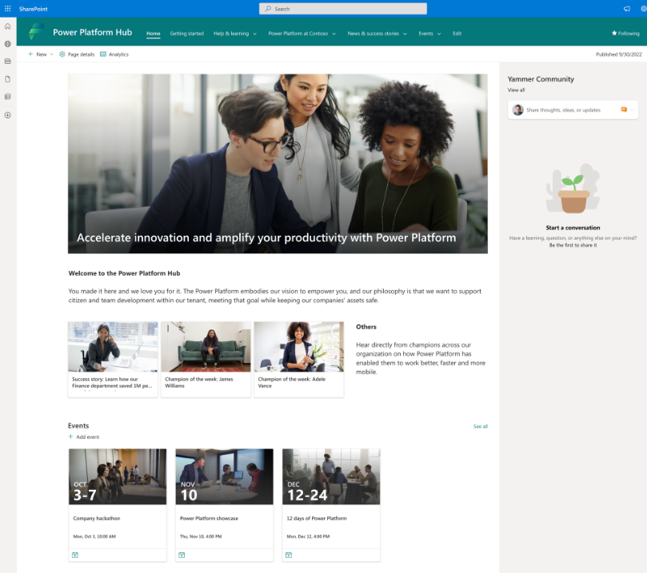
Power Platform Hub
CoE Starter Kit Standalone Add-ons
Your internal Power Platform community and wiki for sharing success stories, upcoming events, rules of engagement and guidelines with your makers. This site should be a one-stop shop for makers to find out everything they need about getting started with Microsoft Power Platform.
Custom SharePoint communication site template which provides you easy way to start building your own Power Platform community portal
https://learn.microsoft.com/en-us/power-platform/guidance/adoption/wiki-community

Slide 24
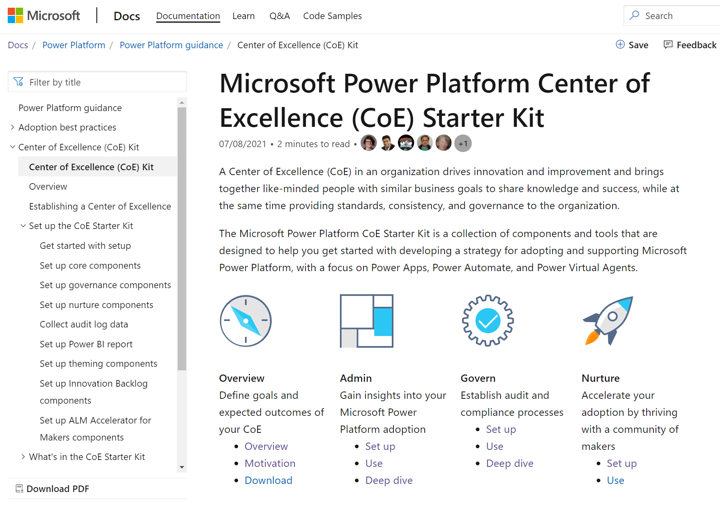
Documentation
Center of Excellence Starter Kit documentation can be found from
https://docs.microsoft.com/en-us/power-platform/guidance/coe/starter-kit
Requirements and limitations
Setup and how to use instructions
Guidelines how update and extend the toolkit
Detailed documentation of each component like individual Flows, Apps etc. of the CoE

Slide 25
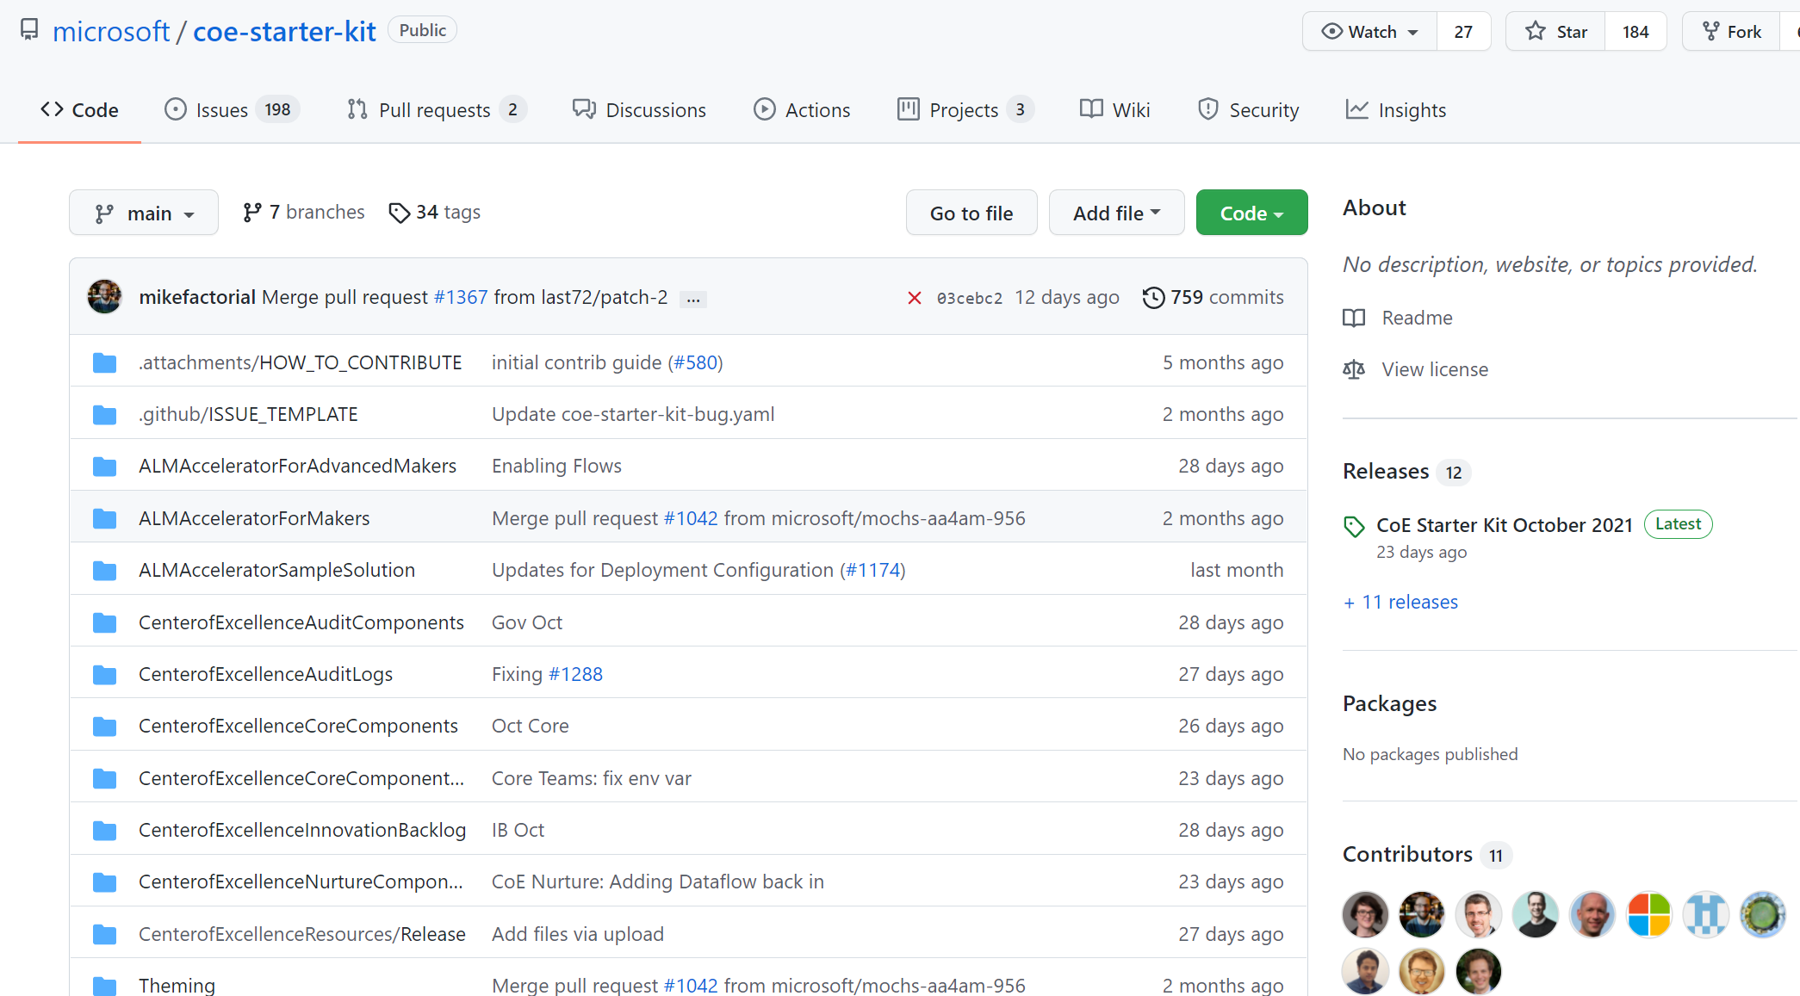
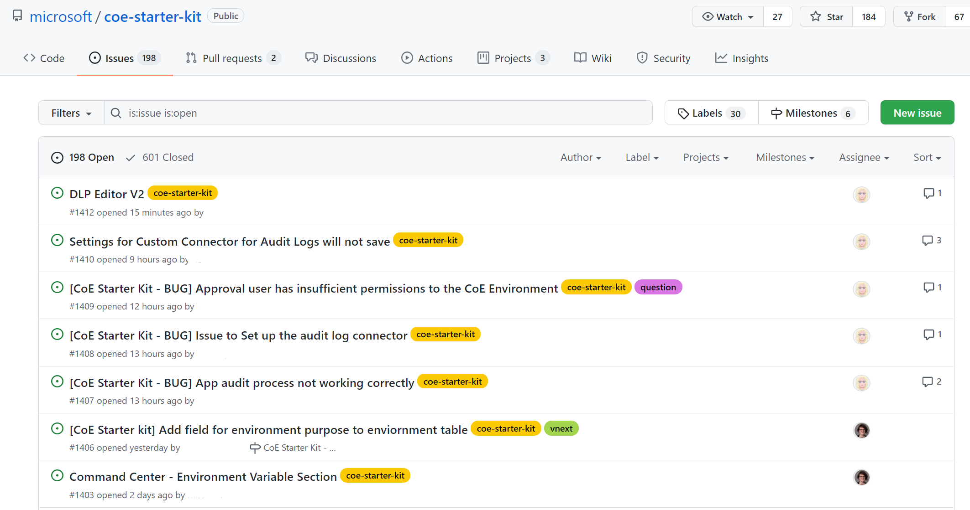
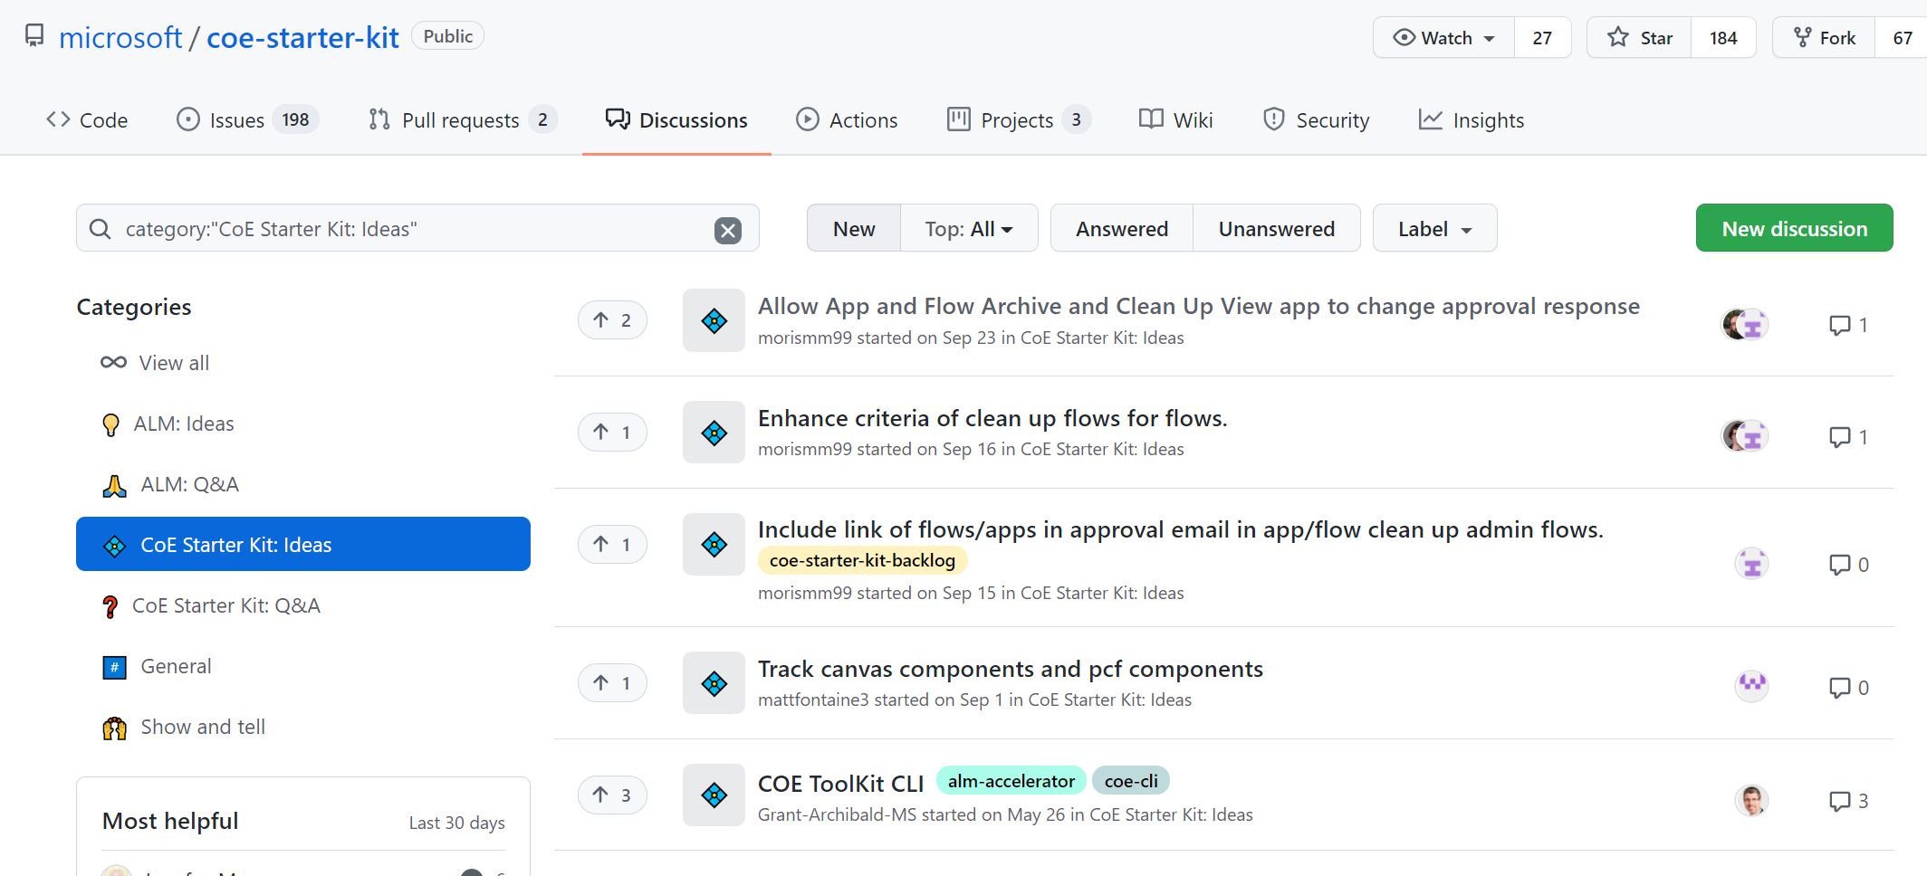
GitHub Repo
Center of Excellence Starter Kit GitHub Repository can be found from
https://github.com/microsoft/coe-starter-kit
Download latest and previous versions of CoE
Report possible issues and get support (not officially supported by MS)
Request new features
Have a discussions and share ideas

Slide 26
Setup Prerequisites
Environment with a Dataverse, where the user installing the solution has the System Administrator security role
Admin Account
Power Platform, Global or D365 Admin for access to all tenant resources through the Power Apps APIs
This solution will work for environment admins, but the view will be restricted to only the environments an environment admin has access to
Must be email enabled
Power Apps Premium license is required to be able to use CoE Power Apps.
Power Automate Premium license is required for CoE Flows.
If DLP policy affects the environment where CoE is installed, then policy should allow all the connectors used in CoE components to be used together (all those connectors either in Business or Non-Business bucket). See full list of connectors used in CoE from Setup Prerequisites.
https://learn.microsoft.com/en-us/power-platform/guidance/coe/setup

Slide 27
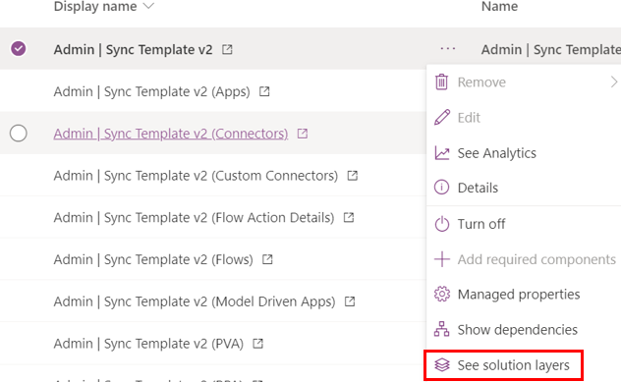
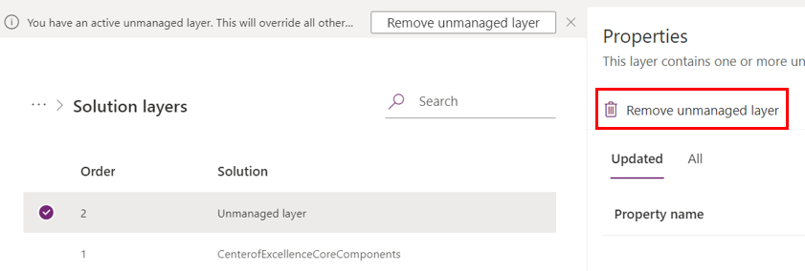
Installing Updates
Periodically, the solution will receive updates with new features, bug fixes, or optimizations. These updates will be announced on the GitHub repo and in release notes.
Updates can be downloaded from https://aka.ms/CoEStarterKitDownload
We recommend upgrading the CoE Starter Kit solution at least every three months.
Install the updates by importing the latest version to the environment where you originally installed the solution and select Upgrade to update the solution.
NOTE! If you have made any changes to the Flows / Apps in the managed solution, they won't receive updates until you remove that unmanaged layer. For every Flow/App that you changed, go to the solution layers and remove it.

Slide 28
Extending Starter Kit
When you're ready to extend the CoE Starter Kit with your own ideas, you'll do so by making modifications to the solution components in your own unmanaged solution.
Choose components from the CoE Starter Kit you want to extend, add it to you unmanaged solution and then create copy of it. Remove the original CoE version of the app/flow from your solution. NOTE, not all components can be copied like parent flows calling child flows (most CoE flows uses child flows).
Extend by making modifications to the copied component in the context of your new unmanaged solution.
Deploy your solution to test and production.
https://learn.microsoft.com/en-us/power-platform/guidance/coe/modify-components
https://learn.microsoft.com/en-us/power-platform/guidance/coe/modify-components#working-with-cloud-flows

Slide 29
Extending Starter Kit - What components can I customize?
Tables and model-driven apps support merging. These resources can easily be extended by creating your own unmanaged solution and making changes there (for example, adding new fields). During an upgrade, you'll receive our changes and also keep your changes.
Canvas apps and cloud flows do not support merging. These resources can only be extended and customized by creating a copy in your own unmanaged solution. During an upgrade, you'll no longer receive our changes, which should be a deliberate choice in order to customize a process and make it fit to your organization.
Cloud flows that are responsible for gathering inventory should not be customized. These flows are frequently updated to fix bugs, gather additional data, or improve performance. If you have additional requirements for what inventory to gather, raise a feature ask or create separate flows for your requirements.
https://learn.microsoft.com/en-us/power-platform/guidance/coe/modify-components

Slide 30
Limitations
CoE Starter Kit has some limitations you need to be aware of few most important listed here. See full list from the documentation
Security groups and approvals - We recommend against using security groups to control access to the CoE environment, because it's likely that users who don't have access to this environment will be participating in approvals
Long running flows – Inventory flow (Admin | Sync Template v3*) can be very resource expensive consuming lots of Power Platform requests. Larger tenants might require a Power Automate Per Flow license to complete in a timely manner.
Trial Licenses – Individual trial licenses (started by user) are not supported as they do not provide necessary performance related paging features required by CoE flows
Flows that are imported or owned by a service principal - The Admin | Sync Template v3 (Flows) flow will fail to collect inventory information for flows that were imported or are owned by a service principal.
Supported languages – CoE Starter Kit solutions are not localized, and only support English
https://docs.microsoft.com/en-us/power-platform/guidance/coe/limitations

Slide 31
Core Solution Deep Dive

Slide 32
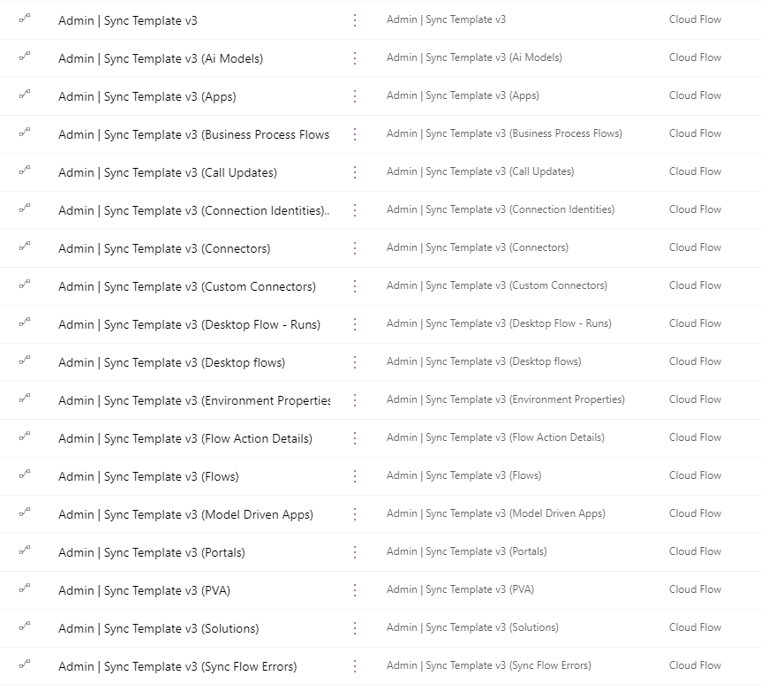
Inventory – Sync Templates
Cloud Flows
Inventory flows gets resource-specific information about your tenant resources like environments, apps, flows, virtual agents. This data is stored in corresponding Dataverse tables
Most of these flows are triggered when the Admin | Sync Template v3 (Driver) flow runs and stores information about Power Platform environments
The first run of these flows will perform a full inventory of every Power Platform resource in your tenant and depending on the size of your tenant, these flows may take a long time to run

Slide 33
CoE Kit BYODL - Self-serve analytics architecture (Preview)
CoE Starter Kit Building Blocks
CoE Kit Bring Your Own Data Lake (BYODL) option offers another way to gather information about Power Platform resources
Currently supports Power Apps, Cloud Flows, Environments, Connections and usage data for Apps and Flows data for the CoE Kit utilizing inventory and telemetry data
This offers much faster way to get inventory data compared to traditional cloud flows option which has had issues especially in large tenant with lots of Power Platform resources
This requires Tenant-Level Analytics enabled in the tenant and Data Export (preview) configured to export inventory data from the platform to Azure Data Lake storage account
Power BI and Power Platform Dataflows are used to fetch and transform data

Slide 34
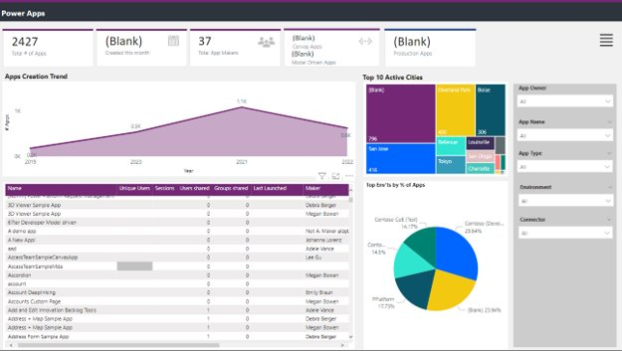
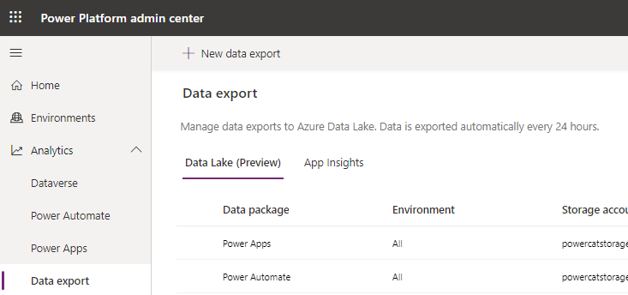


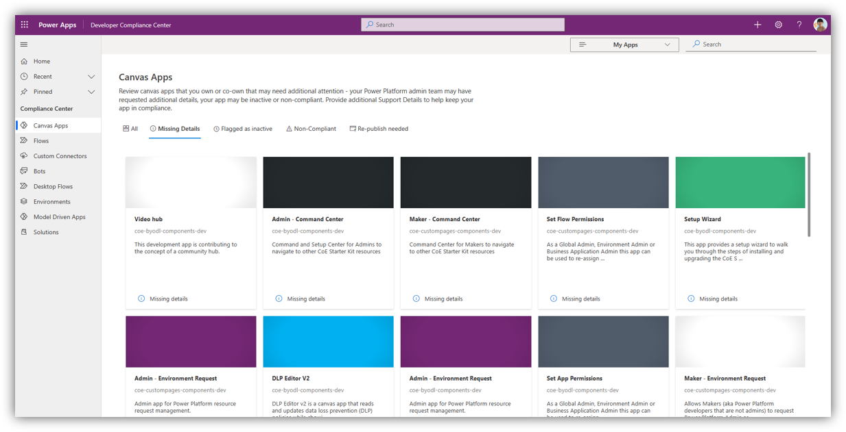
CoE Kit BYODL - Self-serve analytics architecture (Preview)
CoE Starter Kit Building Blocks
Power BI Dataflows prepare the data for the Power BI Dashboard
Inventory and telemetry data is provided by Microsoft to your own Azure storage account
Includes Environments, Power Apps, Cloud Flows, connections and usage of Apps and Cloud Flows
Power Platform Dataflows write minimal data to Dataverse to merge with data gathered through CoE processes

Slide 35
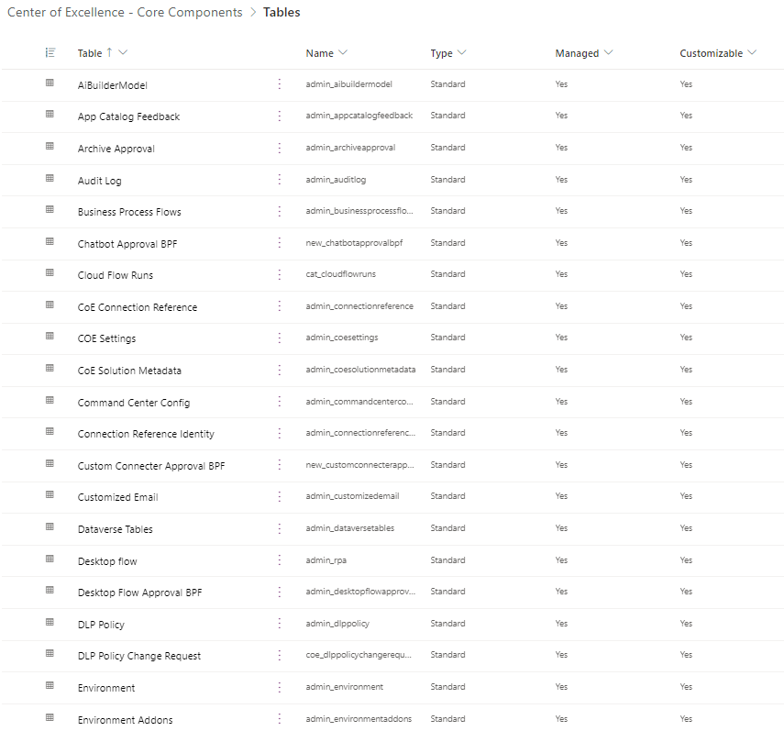
Dataverse Tables
The inventory flows of the CoE Starter Kit sync your tenant resources to the Dataverse tables.
All tables provide information about created by/on and modified by/on, in addition to resource-specific information.

Slide 36
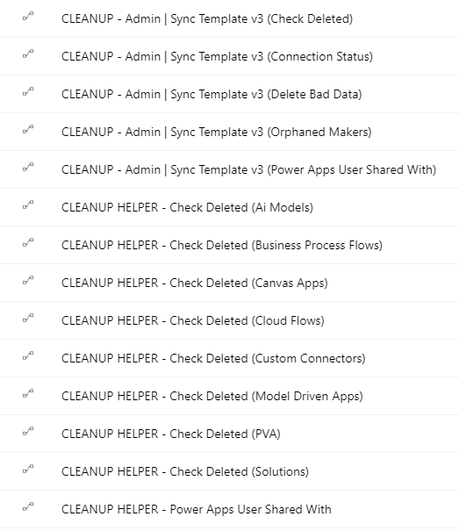
Sync Templates – Cleanup Flows
Cloud Flows
Cleanup specific resources from the Dataverse tables like orphaned makers, Power Apps sharing information, and objects, which are in deleted states.
You can control what resources are really deleted or just marked as deleted using Also Delete from CoE environment variable (Yes/No). Default value is Yes

Slide 37
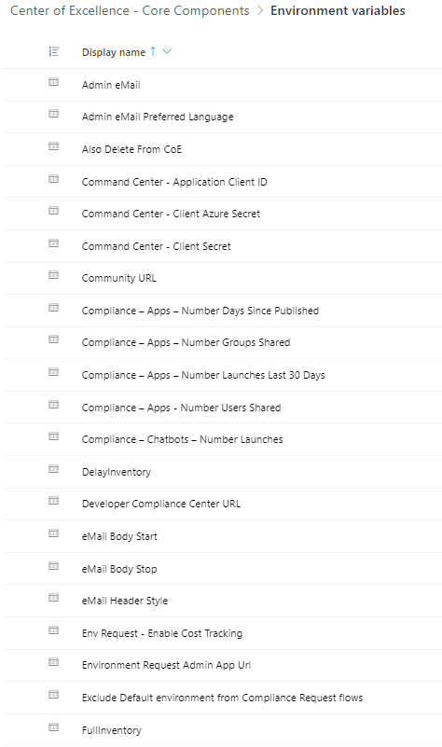
Environment Variables
Core Component contains following environment variables, which are used to define and control certain CoE functionalities and settings. Few examples are:
Admin eMail - Email address used in flows to send notifications to admins; should be either your email address or a distribution list
Power Automate environment variable - The URL used by flow for your region
Also Delete from CoE - Recommend Yes here to delete objects from the CoE inventory when they're deleted from the tenant. No will keep a record that an app or flow existed in the past
Graph URL Environment Variable - REQUIRED. The URL used to get graph information for your cloud. Ex https://graph.microsoft.com
Some can be set during the solution import, and some might be needed to update afterwards depending which CoE components will be used.
Environment variables can be set in new solution view but not updated. To change the value use Admin – Command Center canvas app (recommended) or default solution.
https://learn.microsoft.com/en-us/power-platform/guidance/coe/setup-core-components#all-environment-variables

Slide 38
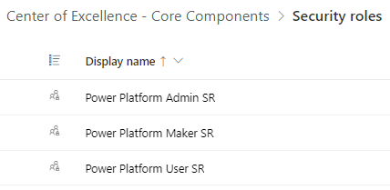
Security Roles
Power Platform Admin SR
Gives full access to create, read, write, and delete operations on the custom tables
Power Platform Maker SR
Gives read and write access to the custom tables (environments, apps, and so on)
Power Platform User SR
Gives read-only access to the resources in the custom tables
https://learn.microsoft.com/en-us/power-platform/guidance/coe/core-components#security-roles

Slide 39
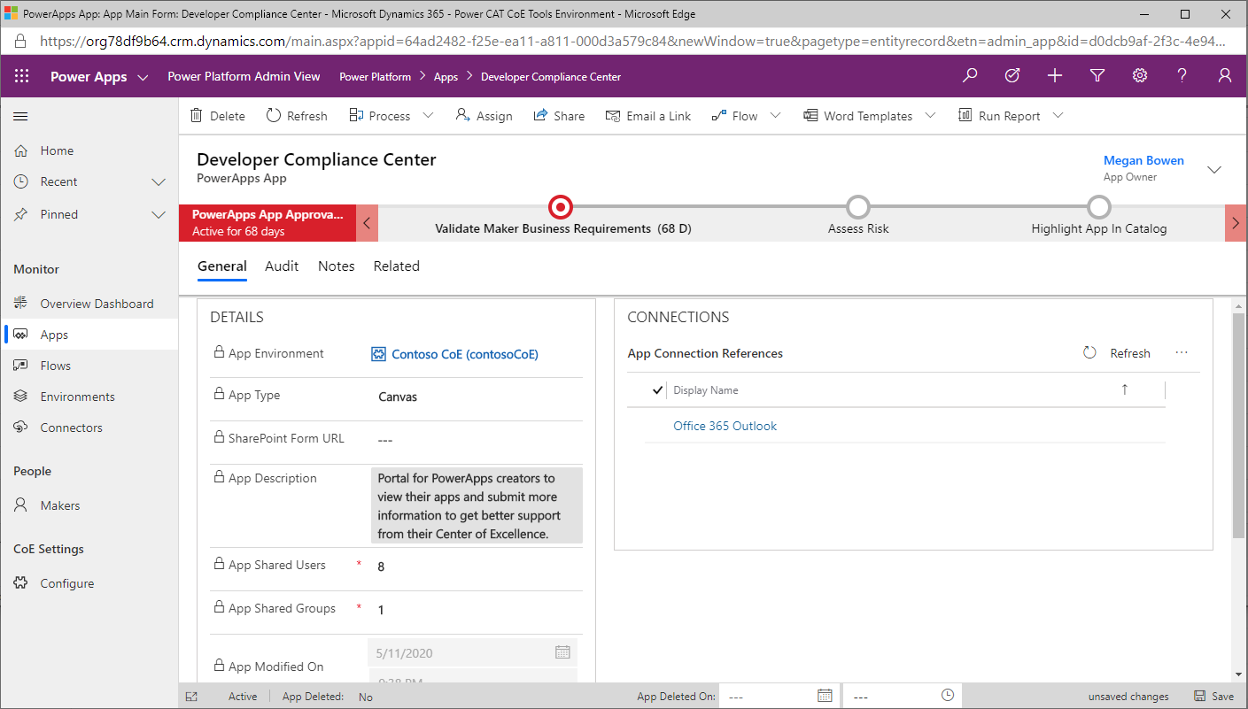
Power Platform Admin View
Model-Driven App
Provides an interface used to browse items in Dataverse custom tables. It provides access to views and forms for the custom tables in the solution.
Use this app to:
Get a quick overview of resources in your tenant
Learn about your makers, connectors, apps, and flows
Find out who apps are shared with
Add additional information, such as notes and risk assessments, to your resources
Set approved capacity for environments, and see capacity and add-on information per environment
Complete app audits

Slide 40
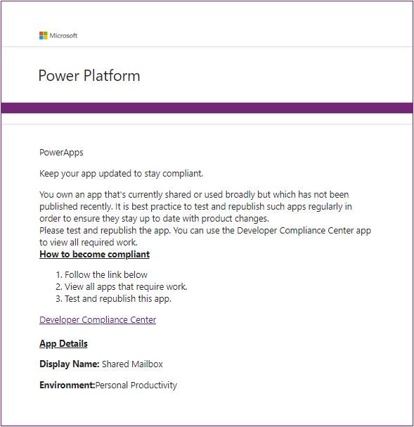
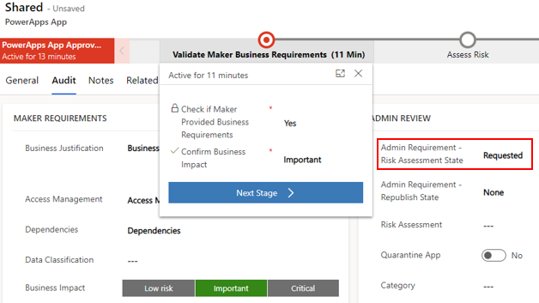
Compliance Detail Request
Cloud Flow
Automatically initiated for Canvas Apps and Chatbots when Admin | Compliance detail request v3 flow is enabled. Thresholds of the following rules are configurable using environment variables
Canvas Apps:
Shared > 20 users or > 1 group, no business justification details provided.
Business justification provided but not published since 60 days (sends email notification to owner)
Business justification provided and an indication of high business impact, but no mitigation plan attached.
Chatbots:
Launched > 50 times and no business justification details have been provided for it.
Business justification details provided and an indication of high business impact, but no mitigation plan attached
Starts Approval BPF for PowerApps and Chatbots if Risk Assessment State is None or Requested (by admin)
NOTE, These features requires CoE Governance component to be deployed and configured in your environment

Slide 41
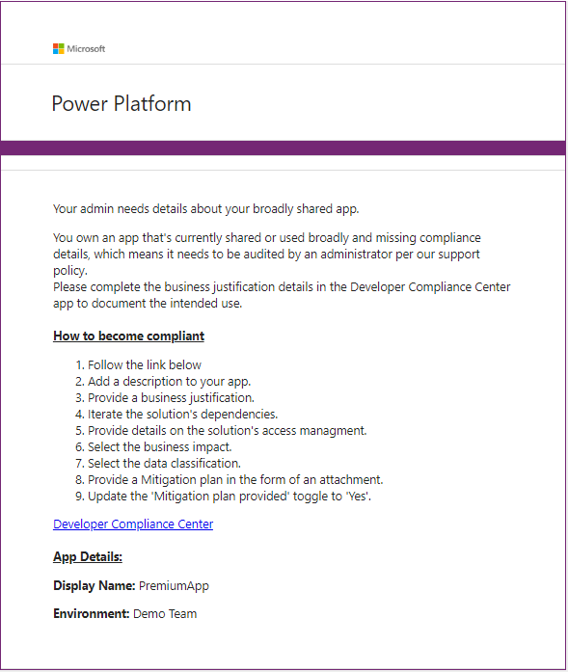
Compliance Detail Request – Initiated by Admin
Cloud Flows
Admins can manually request compliance details update for following resources
Canvas Apps
Chatbots
Flows
Desktop Flows
Custom Connectors
Sends compliance related emails to users when Admin Risk Assessment State is set to Requested
NOTE, These features requires CoE Governance component to be deployed and configured in your environment

Slide 42
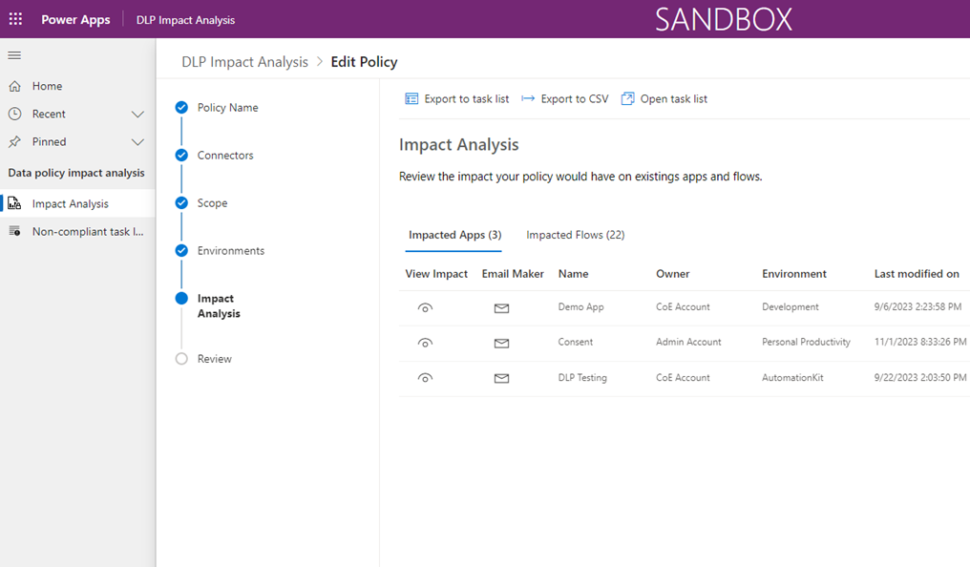
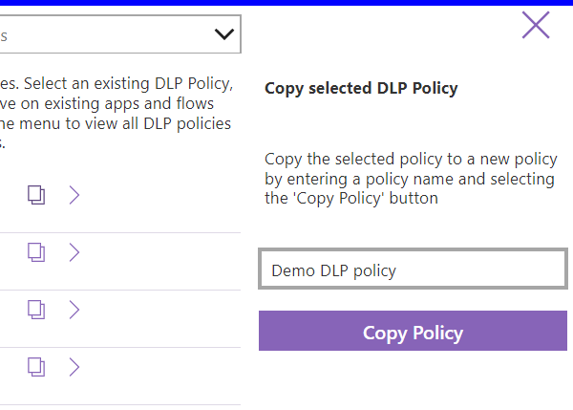
DLP Impact Analysis
Model-Driven App
Reads and updates Data Loss Prevention (DLP) policies while showing a list of apps and flows that are impacted by the policy configurations.
Use this app to:
Make changes to DLP policies
See impact each change will have
Export impacted apps/flows to CSV file
Copy DLP policies

Slide 43
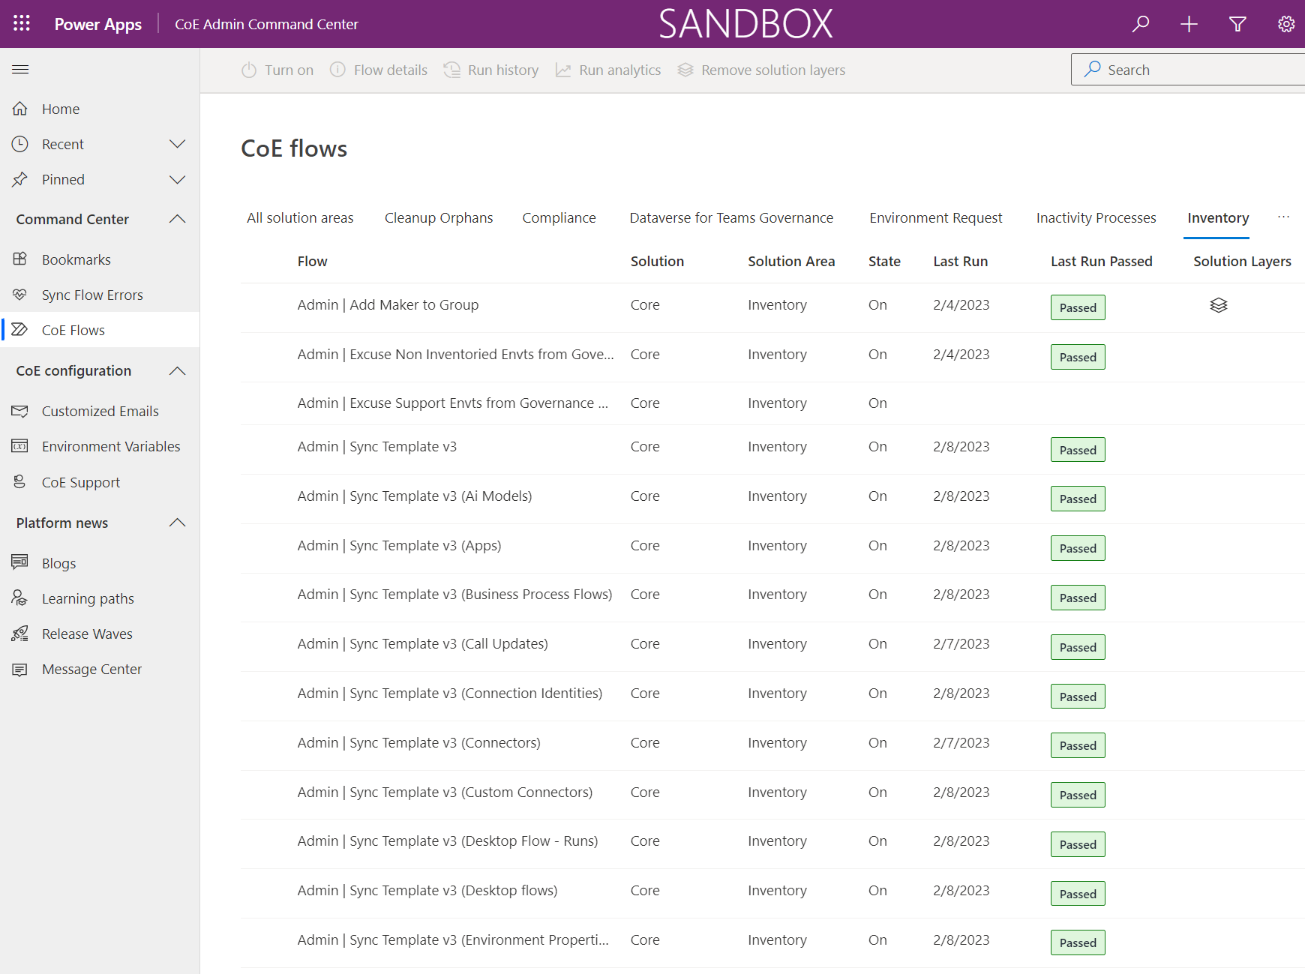
CoE Admin Command Center
Model-Driven App
Used by admins as a starting point to launch other apps in the CoE Starter Kit and review content relevant to admins.
Use this app to:
Launch CoE Starter Kit apps and other bookmarks
Review CoE Starter Kit service health by checking sync flows that have recently failed
Update environment variables used in the CoE Starter Kit
View Microsoft 365 Message Center news related to Microsoft Power Platform
Download the latest CoE Starter Kit version and raise support tickets with the team
Launch Microsoft Learn learning paths to learn more about Microsoft Power Platform
Launch the latest posts of the Power Apps, Power Automate, Power BI and Power Virtual Agent blogs

Slide 44
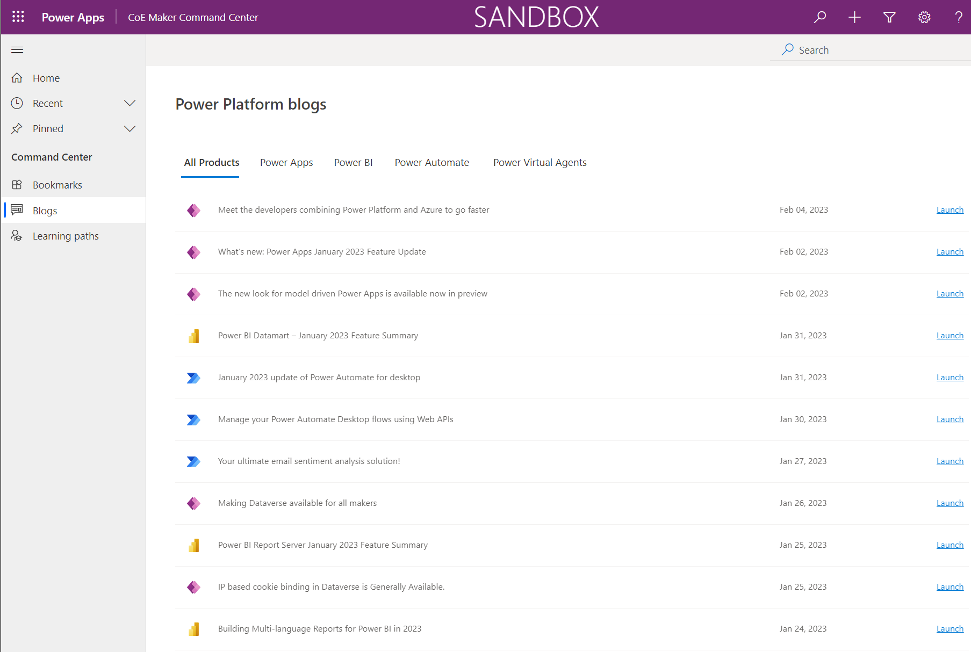
CoE Maker Command Center
Model-Driven App
Used by makers as a starting point to launch apps which admins have published using Admin – Command Center and are relevant to makers like App Catalog and Environment Request
Use this app to:
Launch CoE Starter Kit apps and other bookmarks published by admins
Launch Microsoft Learn learning paths to learn more about Microsoft Power Platform
Launch the latest posts of the Power Apps, Power Automate, Power BI and Power Virtual Agent blogs

Slide 45
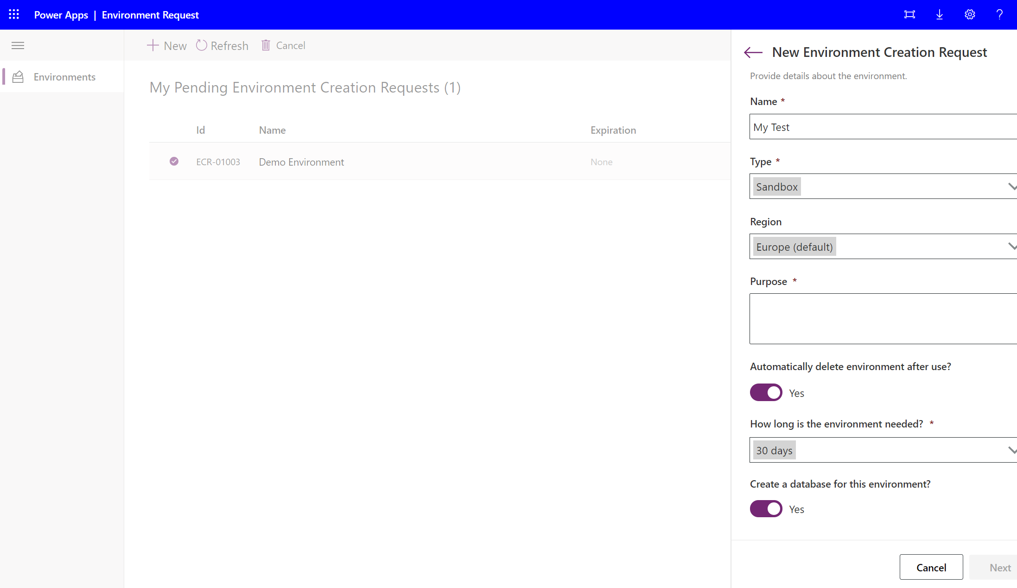
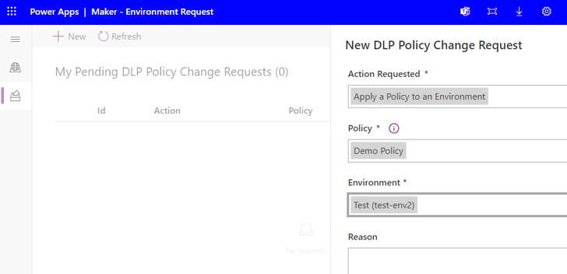
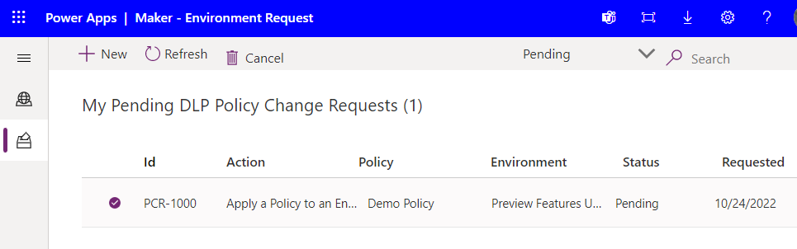
Environment Request
Canvas App
Designed to easily submit Power Platform resource requests
Use this app to:
Submit new and view your existing environment creation requests
Expiration timeline and link to the live environments can be found here
Request DLP policy change, at the moment only apply a policy to an environment is available

Slide 46
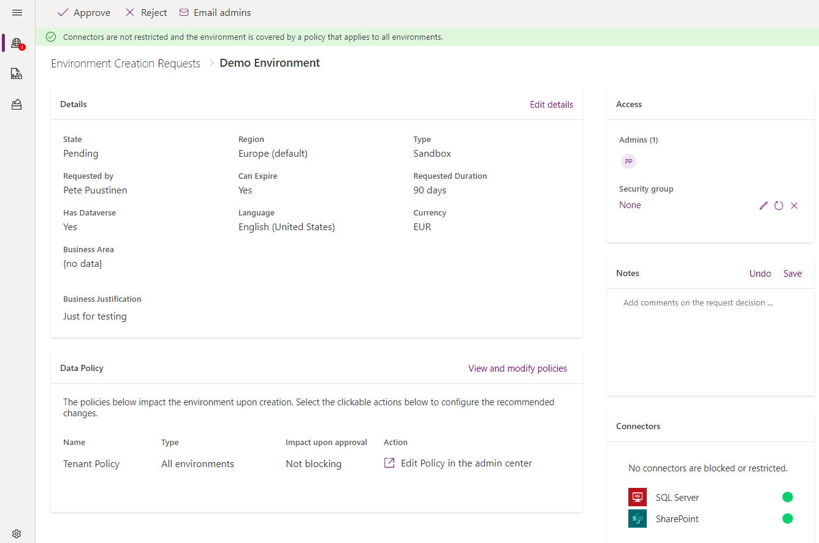
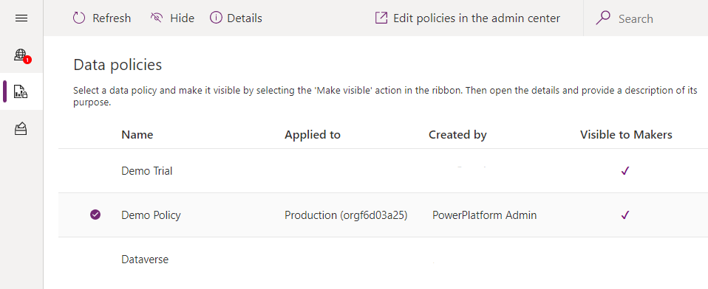
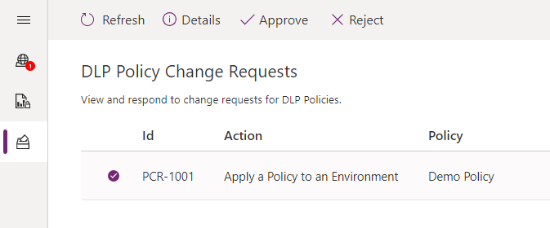
Admin – Environment Request
Canvas App
Used by admins to view and approve/reject requests to create or modify Power Platform Environments
Supports environment creation requests changes to DLP policies are logged in the DLP Policy Change Request table.
Use this app to:
View all Environment creation requests in detail
Approve or reject environment creation requests
View if connectors will be blocked or restricted by existing or modified DLP Policies. Modifications made in the app will update those Policies.
Define which DLP policies are visible to users for creating DLP policy change request
Approve or reject DLP policy change requests

Slide 47
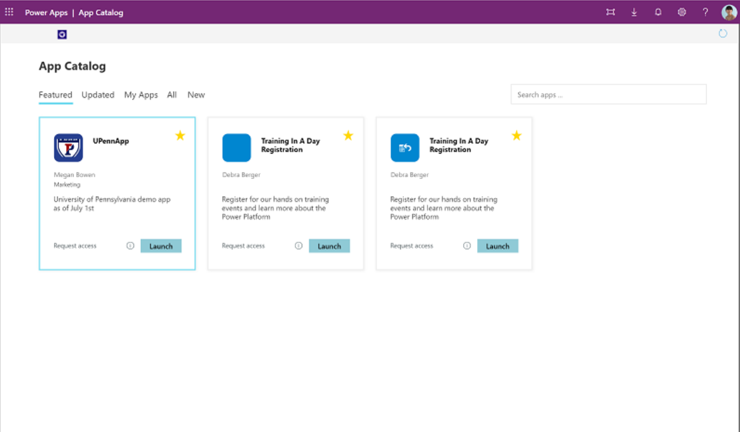
App Catalog
Canvas App
Helps give visibility to certain apps in the organization
Admins can choose which apps to highlight in the app catalog if the app meets admin requirements and is meant to be shared broadly.
To publish an app to the app catalog, follow the app auditing process in the Power Platform Admin View app.

Slide 48
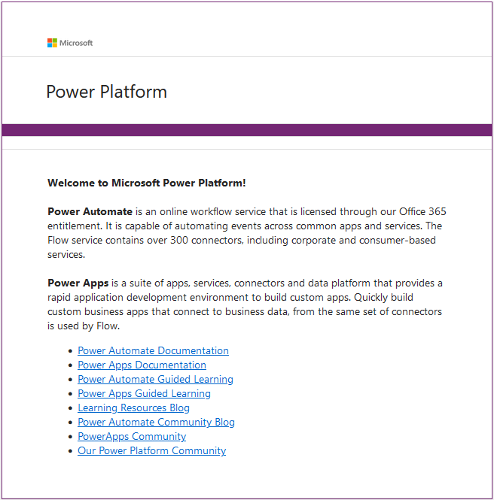
Welcome Email
Cloud Flow
This flow sends an email to a user who created an app, flow, custom connector, or environment.
Gets triggered when a new record is created in the maker table.
You can customize the email sent out by the flow.

Slide 49
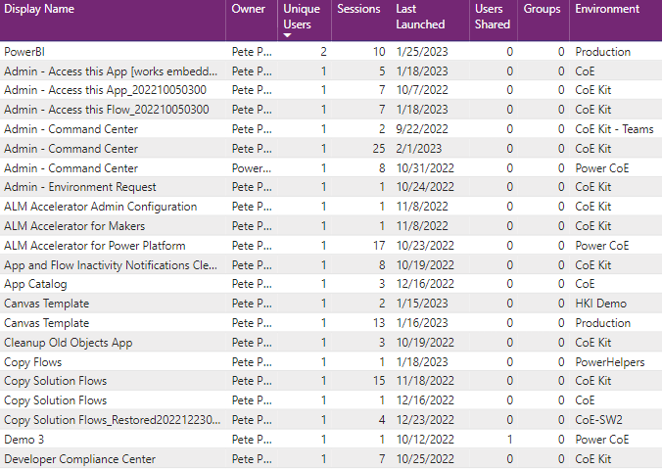
Get Power Apps and Flow events from Office 365 Audit Log
Audit Log
Fetch following Power Platform events from Office 365 Audit Log (Microsoft Purview)
Launch App
Delete App
Delete Flow
Launch App events are stored in CoE AuditLog table and used in the Power BI reports for unique users, sessions and last launched info
Delete App/Flow events flag app or flow deleted and sets the deletion time in CoE PowerApps and Flows tables

Slide 50

Admin | Audit Logs | Office 365 Management API Subscription
Cloud Flow
This flow is used to start the Office 365 Management API subscription. This need to be done before API calls can be made from the CoE Kit flows
You can also stop and list existing subscription(s)

Slide 51

Admin | Audit Logs | Sync Audit Logs (V2)
Cloud Flow
Runs once per hour fetching all Audit Log events from past 60 minutes
Office 365 Management API does not support filtering of events, so flow does the filtering and processes only the events used in CoE Kit
Requires that Office 365 Management API subscription is configured

Slide 52

Admin | Audit Logs | Load events from exported Audit Log CSV file
Cloud Flow
Flow to import old Launch Power App events from the Office 365 Audit Log
Audit Log events need to be exported from Office 365 Audit Log to CSV file which is then uploaded to this flow

Slide 53
Environment Variables
Name | Description | Values
Audit Logs - Audience | The audience parameter for the HTTP calls. | Commercial (Default): https://manage.office.com GCC: https://manage-gcc.office.com GCC High: https://manage.office365.us DoD: https://manage.protection.apps.mil
Audit Logs - Authority | The authority field in the HTTP calls. | Commercial (Default): https://login.windows.net GCC: https://login.windows.net GCC High: https://login.microsoftonline.us DoD: https://login.microsoftonline.us
Audit Logs - ClientID | App registration Client ID. | The application Client ID from the Create an Azure AD app registration for the Office 365 Management API step.
Audit Logs - Client Secret | App registration client secret in plain text. | The application Client Secret from the Create an Azure AD app registration for the Office 365 Management API step. Leave empty if you're using Azure Key Vault to store your client ID and secret.
Audit Logs - Client Azure Secret | Azure Key Vault reference of the App registration client secret. | The Azure Key Vault reference for the application client secret from the Create an Azure AD app registration for the Office 365 Management API step. Leave empty if you're storing your client ID in plain text in the Audit Logs - Client Secret environment variable. This variable expects the Azure Key Vault reference, not the secret. Learn more: Use Azure Key Vault secrets in environment variables

Slide 54
CoE Power BI Dashboards

Slide 55



CoE Dashboard
Provides a holistic view with visualizations and insights into resources in your tenant: Environments, Apps, Flows, Connectors, Connections, Audit Log, Makers etc.
Telemetry from the audit log is stored from the moment you set up the CoE Starter Kit, so over time you can look back and identify trends for longer than 28 days.

Slide 56



CoE Governance Dashboard
Governance dashboard highlights governance, compliance and security insights, allows you to gain a high-level view into your adoption and provides a tech debt report of the Default environment.

Slide 57


Administration Planning
Administration Planning dashboard provides visualizations and insights into what your administration story looks like, based on your task metadata.
You can work directly with the Power BI (.pbit) file and Power BI Desktop to configure and modify the Power BI dashboard to reflect your own branding, and include or exclude visuals that you want to see in the dashboard.

Slide 58



Configure Power BI Dashboards
You can configure and modify the Power BI dashboard by working directly with the Power BI (.pbit) file and Power BI Desktop. This gives you flexibility in terms of modifying the dashboard to your own branding and including (or excluding) pages or visuals you want to see (or not see) in the dashboard.
Download and install Microsoft Power BI Desktop.
Open the dashboard *.pbit file to Power BI Desktop
Copy CoE environment url from the Power Platform Admin Center (PPAC)
When configuring CoE Dashboard or CoE Governance Dashboard, paste the environment URL with https:// prefix
When configuring Power Platform Administration Planning Dashboard, then paste the environment URL without https:// prefix
© Microsoft Corporation Power Platform

Slide 59
Report examples of Power BI Dashboard

Slide 60


Overview – Apps, Flows, Chatbots
For Apps, Flow and Chatbots there are Overview pages providing you with a tenant-wide overview of resources:
Total number of environments (and environments created this month)
Total number of environment makers
Total number of custom connectors
Total number of apps, app makers, and apps created this month
Total number of flows, flow makers, and flows created this month
Total number of bots, bot makers, and bots created this month

Slide 61

Environments
The Environments page shows you how many environments, environment makers, and Microsoft Dataverse instances you have.
The graphs visualize:
The environment creation trend by environment type
The number of resources per environment
The number of environments by type
Top environment creators

Slide 62

Microsoft Teams Environments
The Microsoft Teams Environments page shows you the number of Microsoft Teams environments, environment makers, and resources in those environments you have.
The graphs visualize:
The environment creation trend
The number of resources per environment

Slide 63
Apps
The Apps page provides an overview of apps in your environment:
Total number of apps
Total number of apps created this month
Total number of app makers
Total number of canvas apps and model-driven apps
The number of production apps (a production app has had 50 active sessions, or active sessions by five unique users, in a month)

Slide 64

Cloud Flows
The Cloud Flows page provides an overview of flows in your environment:
Total number of flows
Total number of flows created this month
Total number of flow makers
Flow creation trends
Top five environments

Slide 65

App / Flow Connections
The App & Flow Connections pages shows which resources and makers are using which connectors and—at a high level—which resources and makers are using premium features.
The filters on this page are:
Connector tier (premium or standard)
Connector (for example, Office 365 Users, Dataverse, Azure AD etc.)

Slide 66

App and Flow Risk Assessment
You can use the dashboard to identify overshared and overused resources or resources that use specific connectors.
Not only will you have visibility to those types of resources, you can grant yourself ownership to inspect the resource behavior and decide whether you need to take further action.
Identify widely shared apps/flows
Identify orphaned apps/flows
Identify implicitly shared app/flow connections

Slide 67

App License Assessment
You can use the App license assessment page to view apps that use premium or standard features and drill down into connectors, departments or makers that are using premium connectors.

Slide 68

App, Flow and Desktop Flow Archive
Identify unused apps, flows and desktop flows by monitoring their archive score: in short, the higher the score, the more likely it is that you can safely archive the resource.
The highest possible score for an app is 8. Max score represents an app that hasn’t been never modified, is using word like test or demo in the title, was created over three years ago and is likely created from a template.
The highest possible score for a flow is 11. Max score represents a flow that hasn't been modified since it was created, is using word like test or demo in the title, was created over three years ago, was likely created from a template, is suspended, is orphan and isn't complex (contains fewer than five actions).
The highest possible score for a desktop flow is 6. A score of 6 represents a desktop flow that hasn't been modified since it was created, is using word like test or demo in the title, was created over a year ago, and was likely created from a template.

Slide 69
Questions?

Slide 70
LAB – CoE Starter Kit Core and Audit Log solutions
Lab Description
Install and configure CoE Starter Kit Core solution
Register Azure AD service principal and configure Office 365 Management API custom connector
Install and configure CoE Starter Kit Audit Log solution
Notes:
Link to lab: https://labondemand.com/LabProfile/
##########

Slide 71
LAB – CoE Starter Kit Power BI Dashboard
Lab Description
Configure Power BI Dashboard
Install and use embedded Apps for Power BI Dashboard
Notes:
Link to lab: https://labondemand.com/LabProfile/
##########

Slide 72
Microsoft

